Slide 1
2024 Station Camp Middle School Football
Coach Thomas

Slide 2
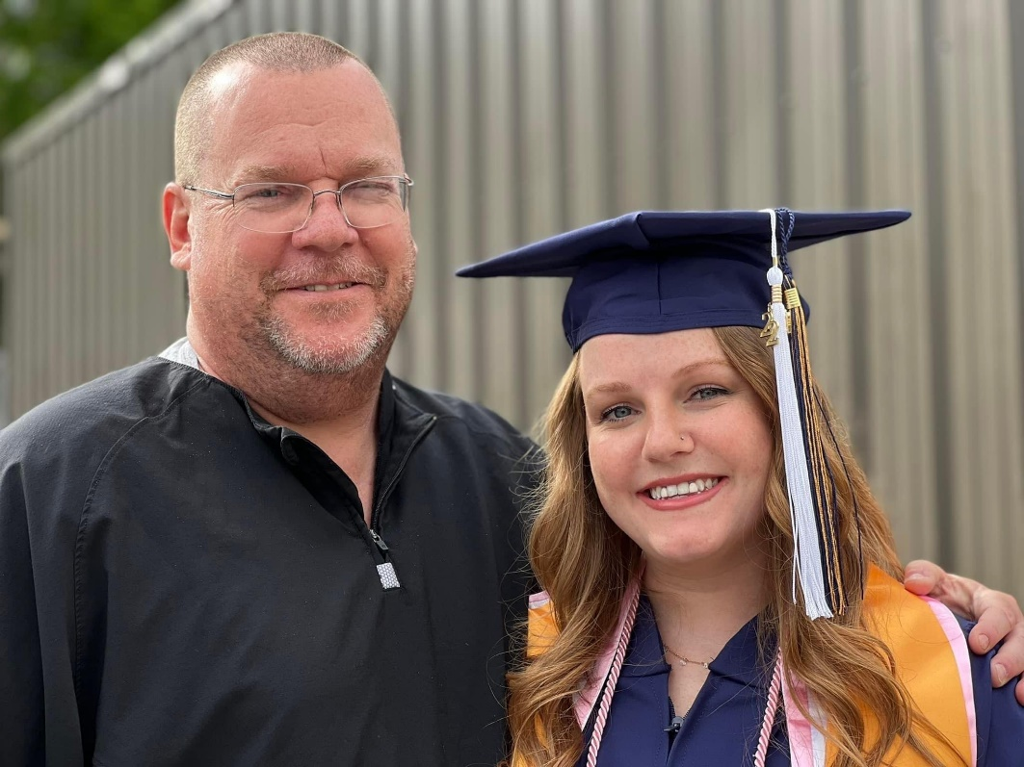
The High School Connection
Chris Bain – High School Head Coach

Slide 3
It’s a GREAT DAY to be a BISON!
Coach Thomas’ Pillars of Success
Character
Mental Toughness
Hard Work
Mission of SCMS Football
Improve each day
Challenge one another
Create a culture of purpose and belonging
Create the best Middle School Football Program in Middle TN

Slide 4
PHYSICALS!
All players must have a physical on file using Final Forms before participating in conditioning and Spring Practice.
All players need physicals dated after 4/15/2023 to participate in conditioning and Spring Practice
Physicals dated after 4/15/23 are good until 5/31/24
Physicals dated after 4/15/24 are good until 5/31/25
Spring practice dates: 4/18/24-5/3/24
Go to www.sumner-tn.finalforms.com
Complete parent/guardian registration
Go to email to confirm account and add student information
Register student for ALL sports of interest for next school year

Slide 5
SCMS Football Program structure
Community
Commitment/Family
Communication
Fiscal responsibility

Slide 6
Community & Family
Get involved
Get others involved
Make it an experience to look forward to
Have fun

Slide 7
Commitment
Player and Parent Expectations
Calendar – www.scmsfootball.weebly.com
Keeping priorities
Faith, Family, School, Football

Slide 8
Communication
Coach to Parent (Remind/Calendar/Website/Facebook)
Parent to Coach (Direct e-mail/Remind)
Player contact form
Player to Coach (Directly)
Calendar – DEAD PERIOD (Go on vacation here!)
Remind Text Alerts!!
1. Go to www.remind.com or download the Remind app on your phone!
2. Create an account
3. Join our team using the code: ​87fcgeg

Slide 9
Fiscal Responsibility
Football Expenses $450 non-refundable fee (Cash or Check to “SCMS”) due July 12th
Covers team apparel, game socks, team meals, referees, and use of facilities and equipment

Slide 10
Team needs
Team Mom’s
Help with team meals, outside football communication, tailgate set-up, etc.
Communication from Coach Thomas
Help collecting water/Gatorade for team meals

